Slide 1
Workshop
IED Digital Fabrication for Interaction

Slide 2
Context
In this workshop your role will be “Product Designer” and everything involved below it (design, architecture, fabrication, tests, manufacturing considerations, etc.)
Your client will be the company “Water Inc.” who has interest in focusing their communication in a younger, healthier, hard-workers public.

Slide 3
Needs from Water Inc.
Target public: young people, sports lovers, healthy-life lovers, office-people, medium-high class.
Interest: Launch a technology-related campaing, to offer a fresh, innovative image.
Interest: get data from users.
Interest: Measure water consumption from users.
Interest: Provide alerts, data visualization from real data on real time.
Interest: Big-Data, IOT world, security, easy UX.
Interest: low-cost, wide solution for all products.

Slide 4
References

Slide 5
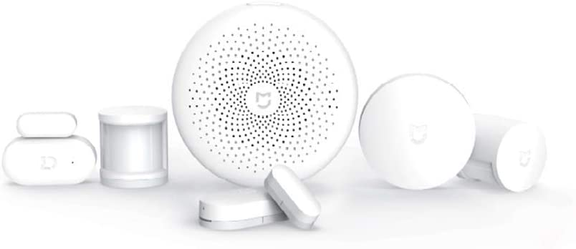
Smart Home Devices
Smart thermometers, etc.
Smart lightning.
Smart bands.
Smart watches.
etc.

Slide 6
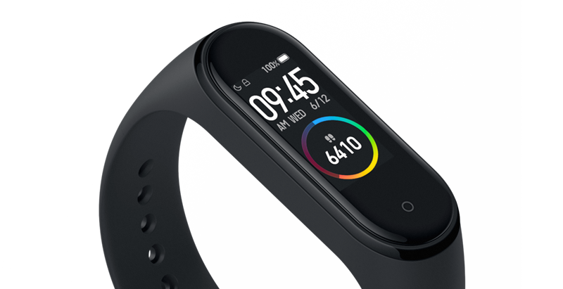

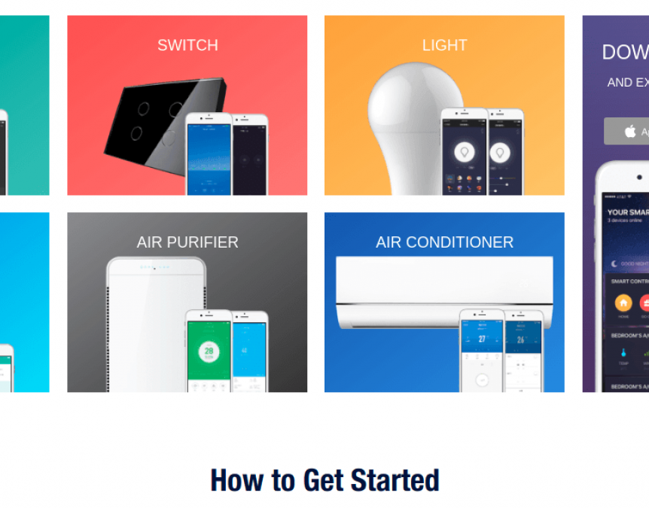
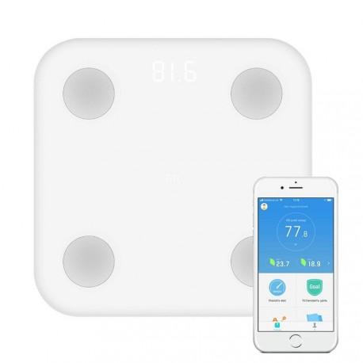
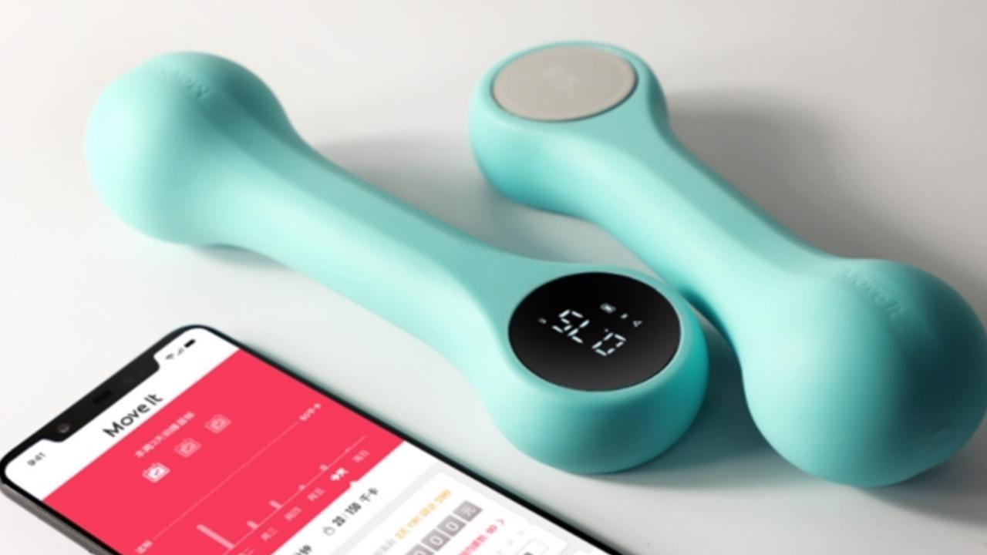
Product Design
Experience Design
Product Design Part. Define Architecture, technology, overall solution adopted.
UX Design Part. Define the user experience in the proposed solution.

Slide 7
Things to Define Today
Overall Solution adopted
30 min. - All
Hardware Design
30 min - all
UX Design
30 min - all
Product Design
30 min - all
Visual Design
30 min - 2 people

Slide 8
Let’s Start!
Water Inc. is looking forward your proposal...

